Slide 1
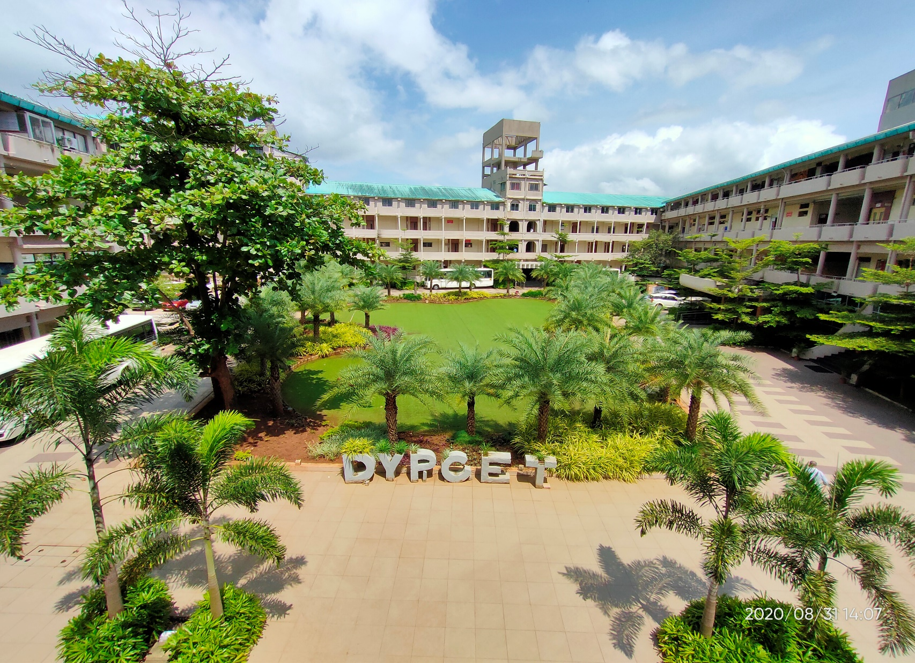
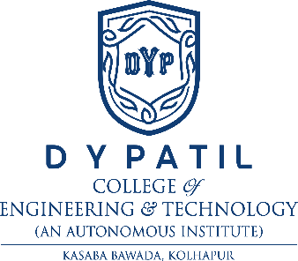
D. Y. Patil College of Engineering and Technology
(An Autonomous Institute)
38 years of Excellence in Technical Education
Dr. Litesh V Malade
Registrar
Notes:
Photo by Jakob Owens on Unsplash

Slide 2
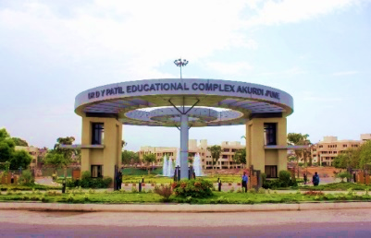
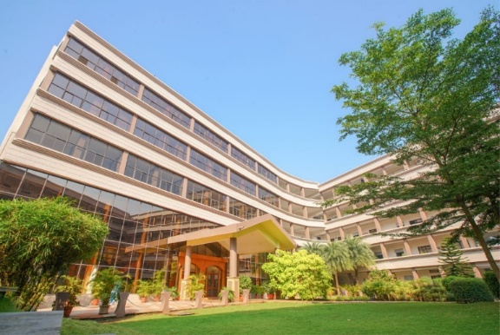
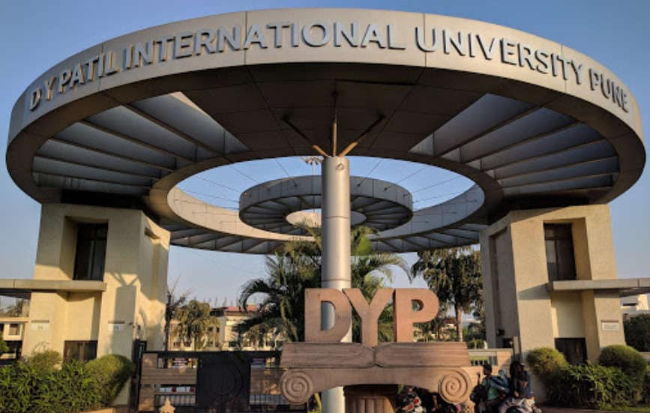
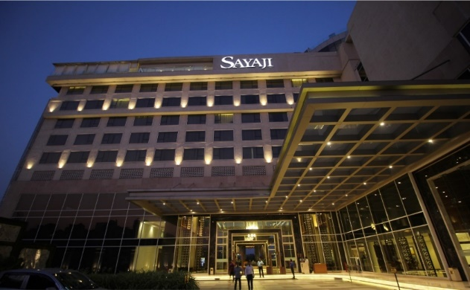
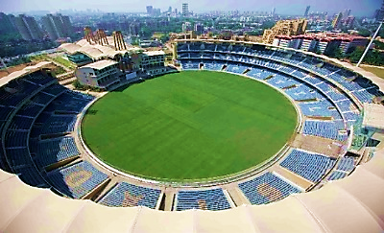
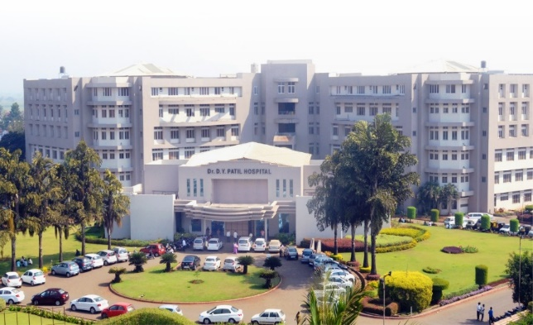
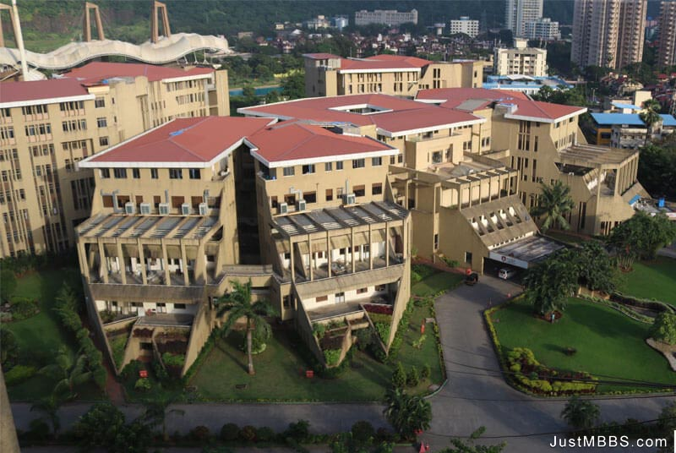
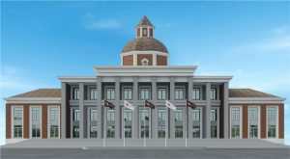
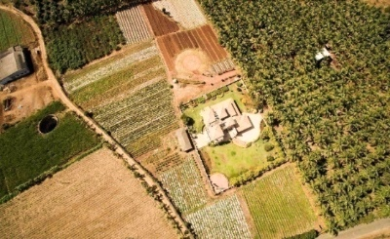
D. Y. Patil Group
Largest self-financed educational group in the state of Maharashtra
182 Institutes
Three Deemed Universities
Four State Private Universities
3.75 Lacs + Alumni
22,000+ Employees
3 Universities & 7 Institutes in NIRF 2021
Our Campuses :
Navi Mumbai
Akurdi, Pune
Pimpri, Pune
Lohegaon, Pune
Talegaon, Pune
Kasaba Bawada,Kolhapur
Talsande, Kolhapur
Salokhe Nagar, Kolhapur
Gargoti, Kolhapur

Slide 3
About DYPCET
Established in the year 1984.
38 years of excellence in Technical Education.
Accredited by NAAC with ‘A’ Grade.
Permanent Affiliation by Shivaji University.
Autonomous status by UGC, New Delhi.
Accredited by NBA.
Extended Approval by AICTE for next 10 years.
2(f) and 12(B) Certification by UGC, New Delhi.
16000 plus alumni working across the globe.

Slide 4
Programs Offered (UG)
Program
Sanctioned Intake
Duration
Architecture | 80 | 5 Years
Chemical Engineering | 60 | 4 Years
Civil Engineering | 120 | 4 Years
Computer Science and Engineering | 180 | 4 Years
Electronics and Telecommunication Engineering | 60 | 4 Years
Mechanical Engineering | 120 | 4 Years
CSE (Data Science) | 120 | 4 Years
CSE (Artificial Intelligence & Machine Learning) | 60 | 4 Years

Slide 5
Why DYPCET (Autonomous), Kasaba Bawada?
Industry Based Curriculum Under Autonomy.
In line with NEP2020, Curriculum focus on Multidisciplinary approach, Innovation, Design Thinking and Life Long Learning.
400 Hours Compulsory Training on Coding to Students of all Branches.
Finishing School - Soft Skill and Company specific training for Job Enhancement in all Eight Semester.
Innovative Internship Program offering Social Internship of 2 weeks after first year, Industrial Internship of 4 weeks after 2nd and 3rd Year and Research Internship of 4 weeks in fourth year.
Minors and Honors Degree in Internet of Things (IoT), Cyber Security, Robotics and Industry 4.0, Food and Nutrition Technology and Environmental Sustainability.
Highest Placement in the Region.
42 Gold Medals and 264 Ranks at Shivaji University (First Rank in Merit Scholarship – Urban Category)

Slide 6
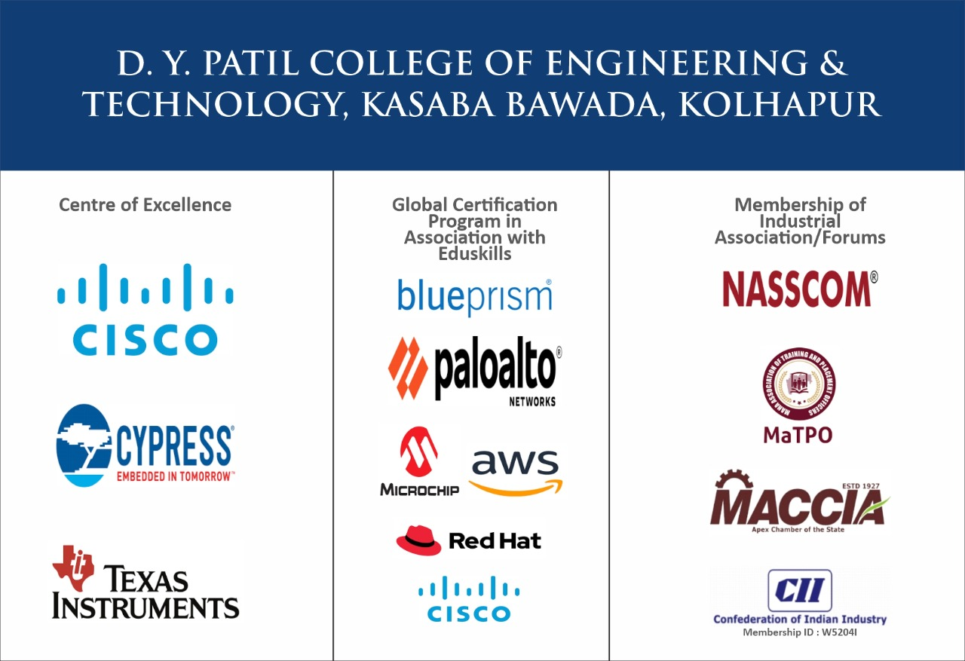
Institutional Linkage and Interaction

Slide 7

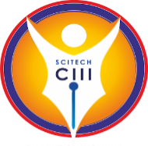
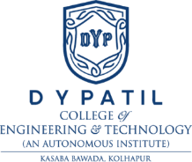
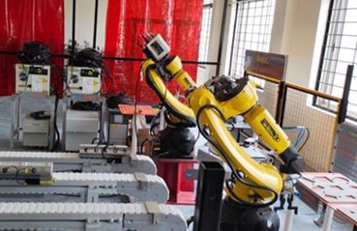

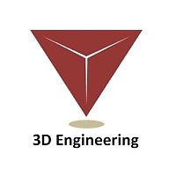




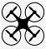





Center for Invention, Innovation & Incubation (CIII)
Funding
35 Cr
Centre of Excellence
Industry Partners
Mechatronics
Robotics
CAD/CAM/CAE
(Siemens Software)
Drone Technology
Agricultural Technology
GIS Mapping
Notes:
Objectives –
Developing an Entrepreneurial Ecosystem through –
Skilling / upskilling/ reskilling, Employment Enhancement
Research & Development, Innovation and Incubation, Consultancy

Slide 8
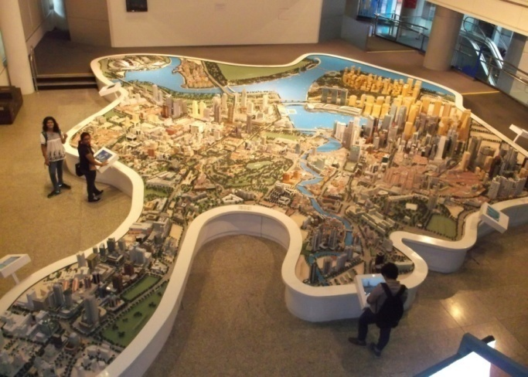
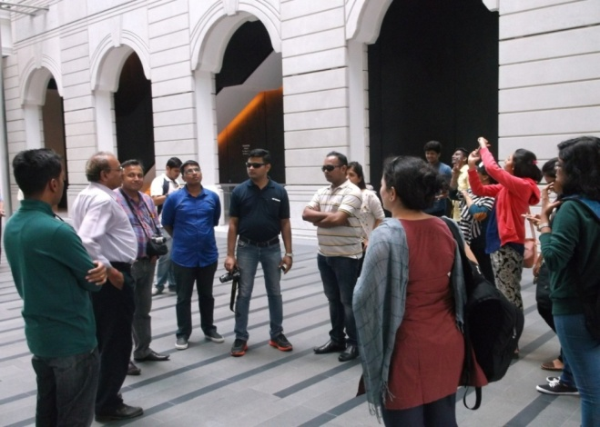
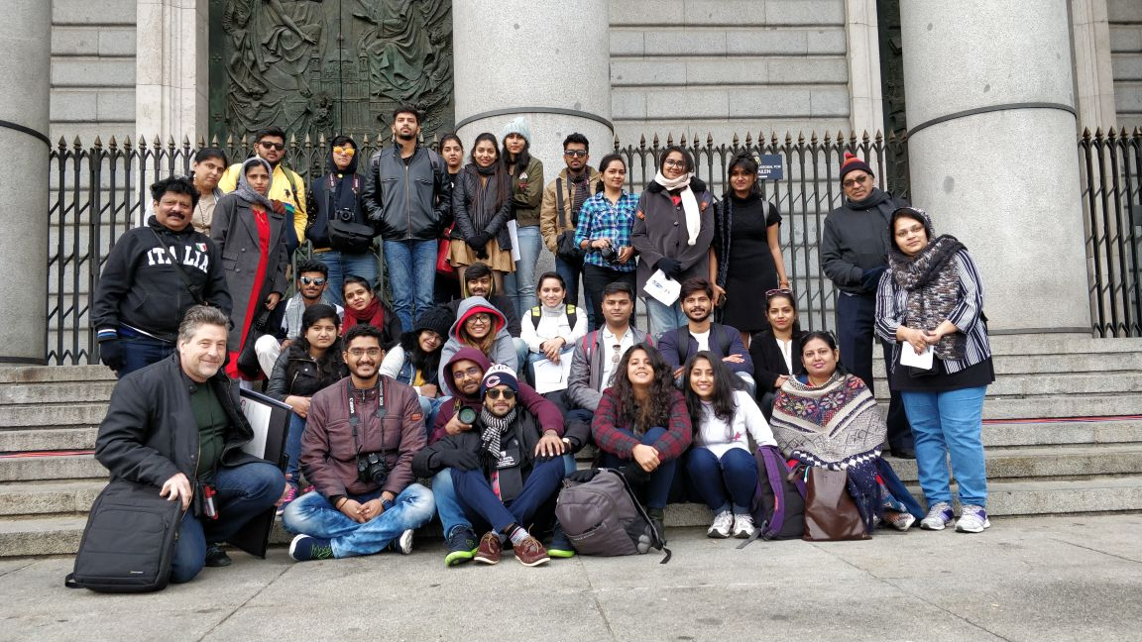
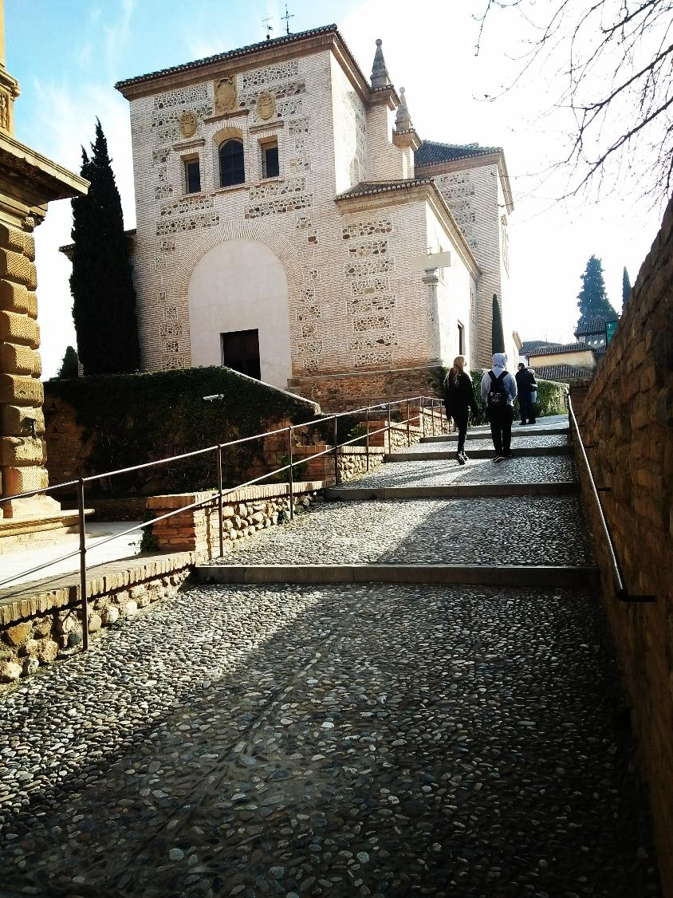
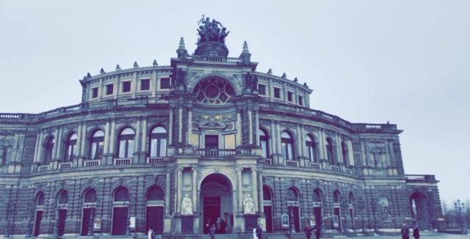
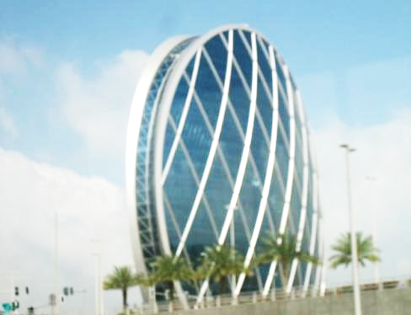
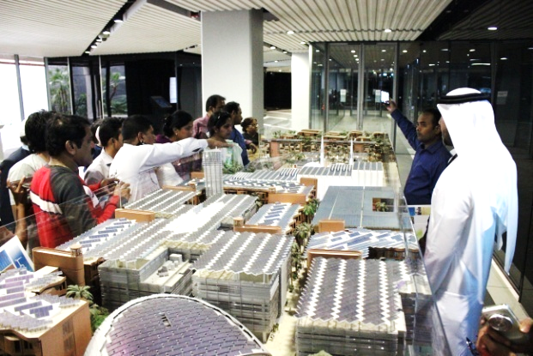
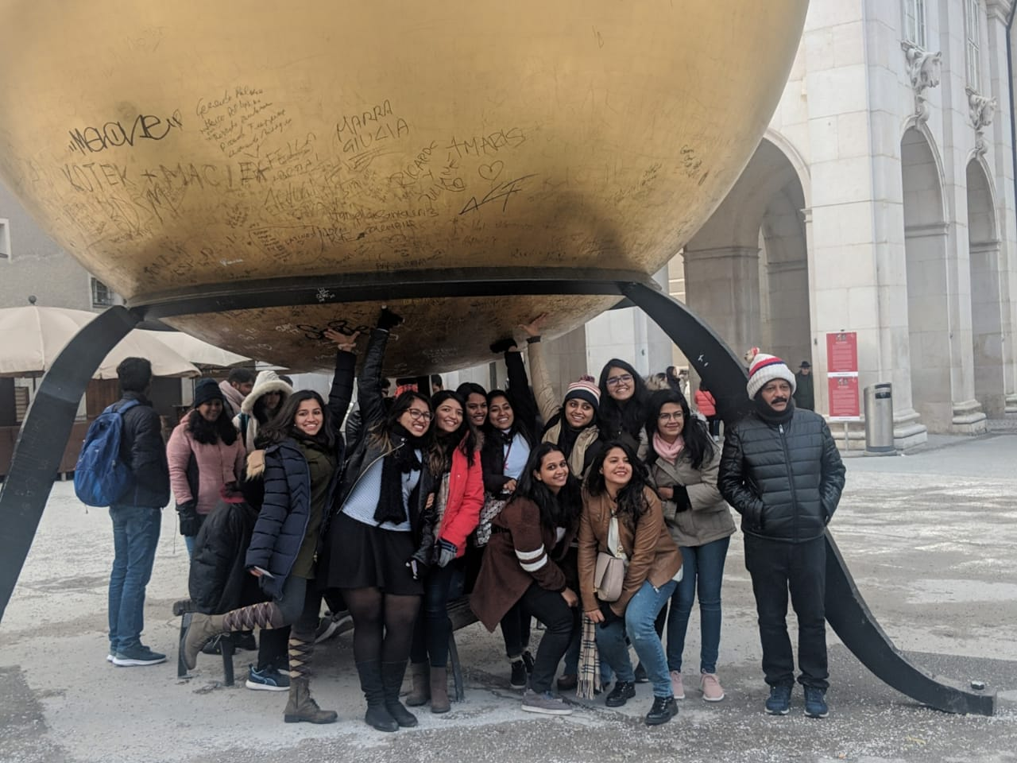
International Study Tours
Singapore
Spain
Dubai
East Europe

Slide 9
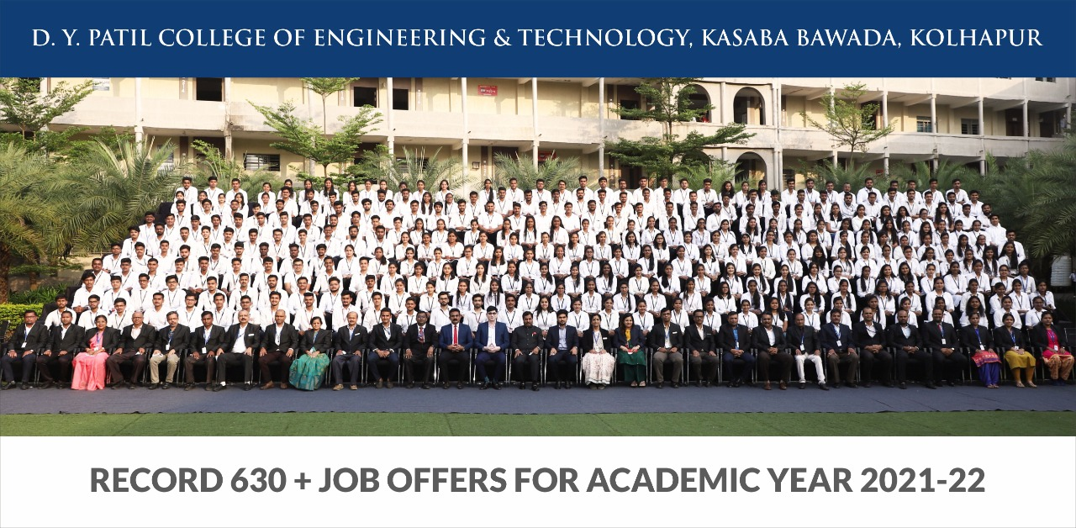
Placements
630+
200+
100+
Above 10 LPA :10 Plus
Above 5-8 LPA :30 Plus
Above 4-5 LPA :228 Plus
Total Job Offered
Campus Placement Drives
New Recruiters

Slide 10
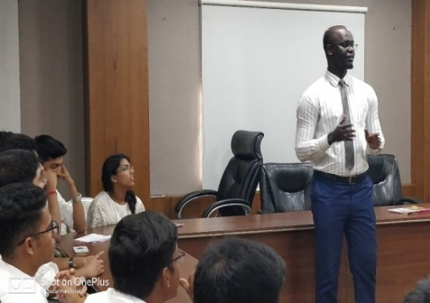
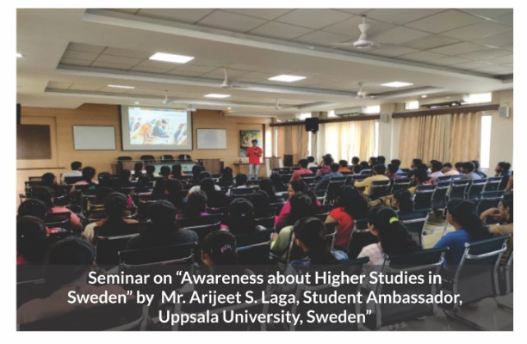
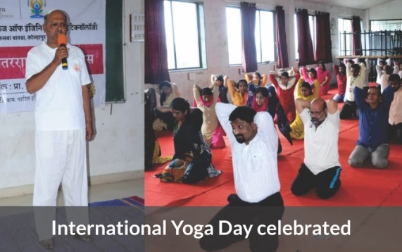
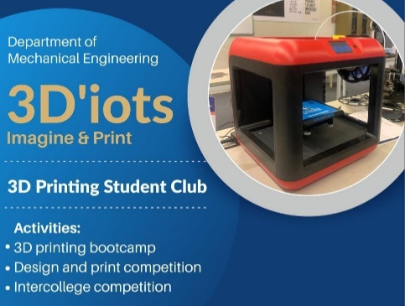
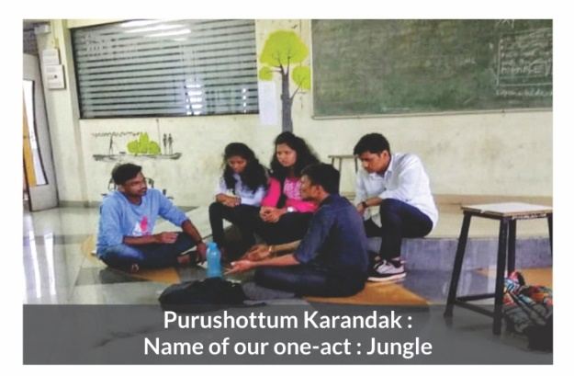
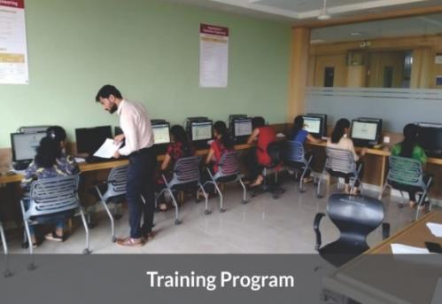

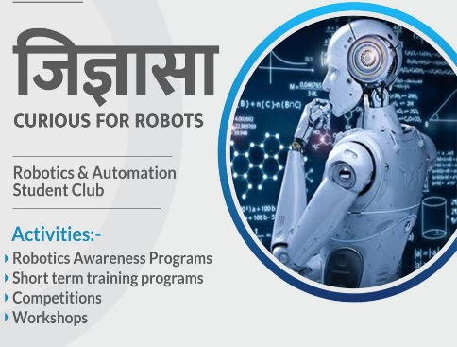
Student Clubs
Foreign Languages Club
Higher Education Club
Health & Fitness Club
3D Printing Club
French, German, Japanese
Art Craft & Culture Club
Coding Club
Adventure Club
Jignyasa Club

Slide 11
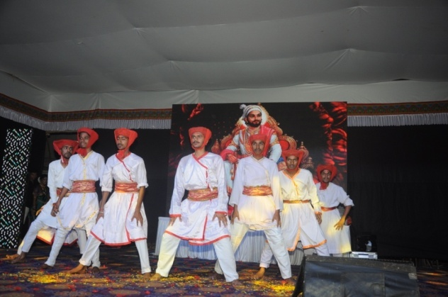
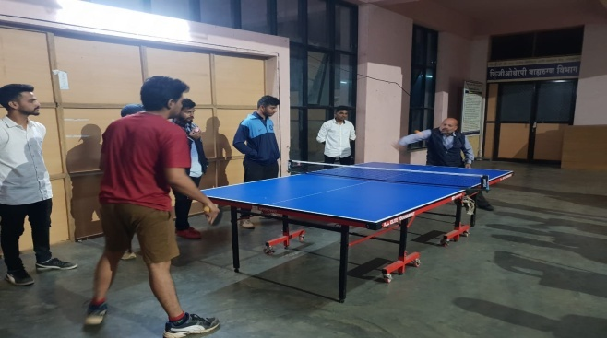
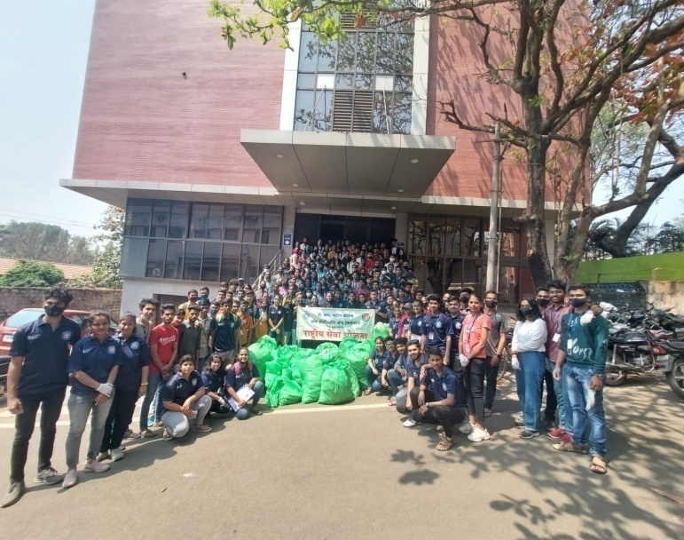
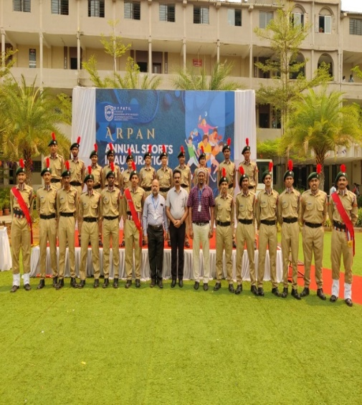
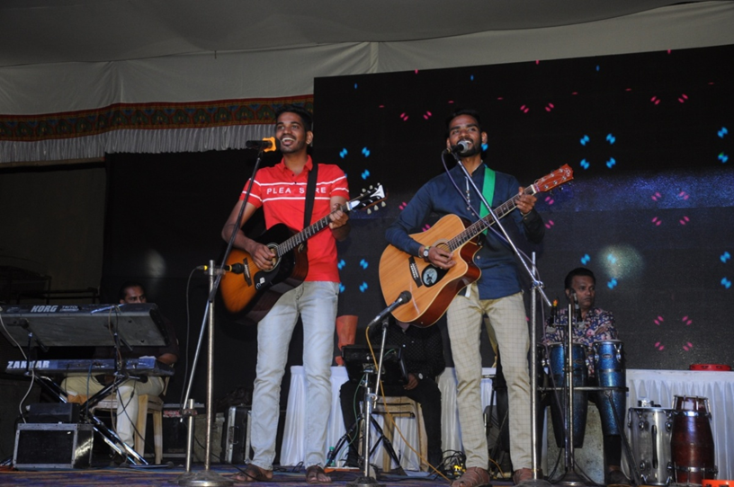
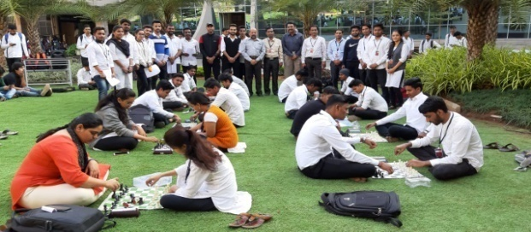
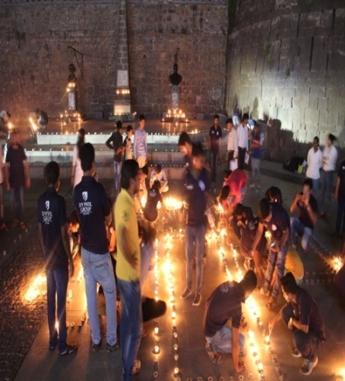
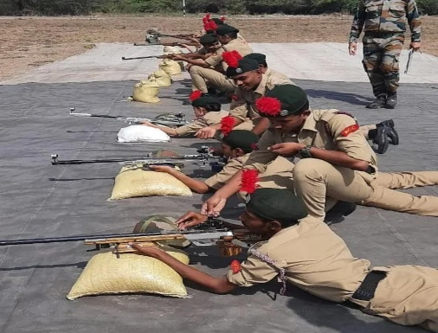
Cultural, Sports, NSS & NCC Activities

Slide 12
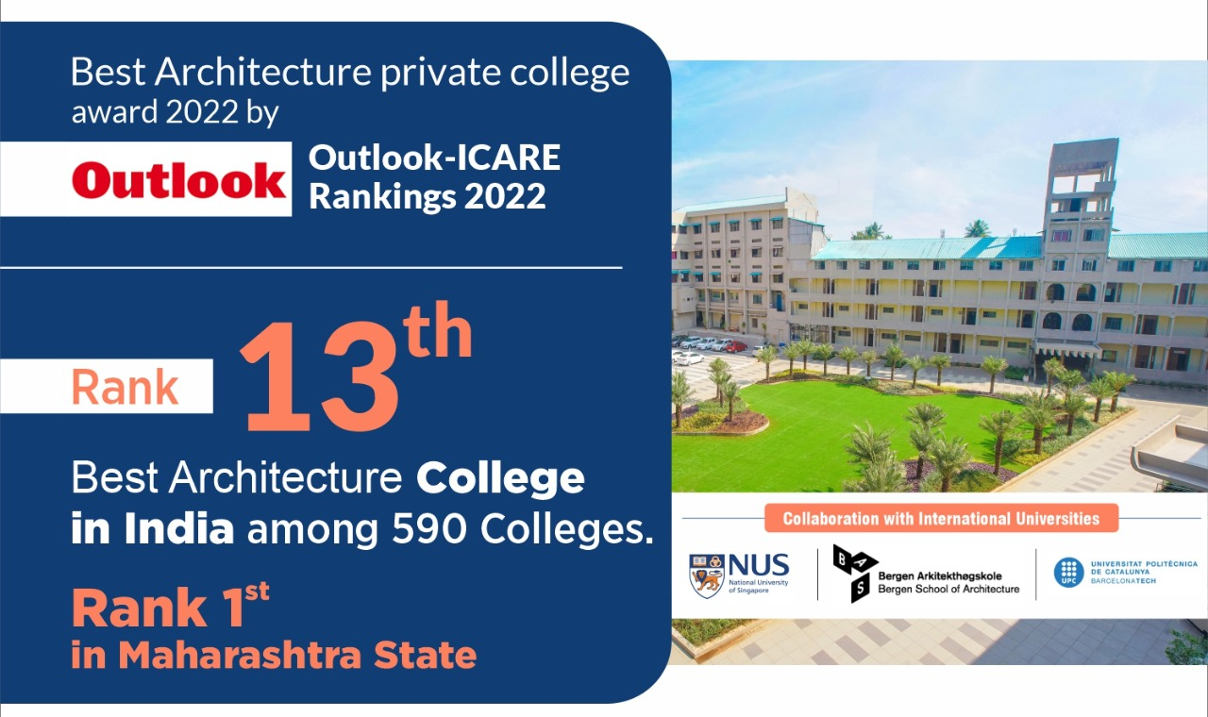
Architecture

Slide 13
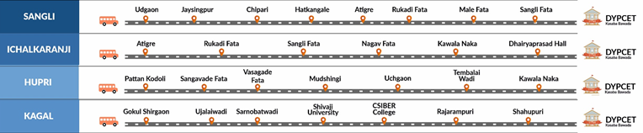
Bus Facility
Bus Routes
Other Routes are from -
Bhogavati
Kuditre
Gargoti
Ashtta
Bambawade

Slide 14
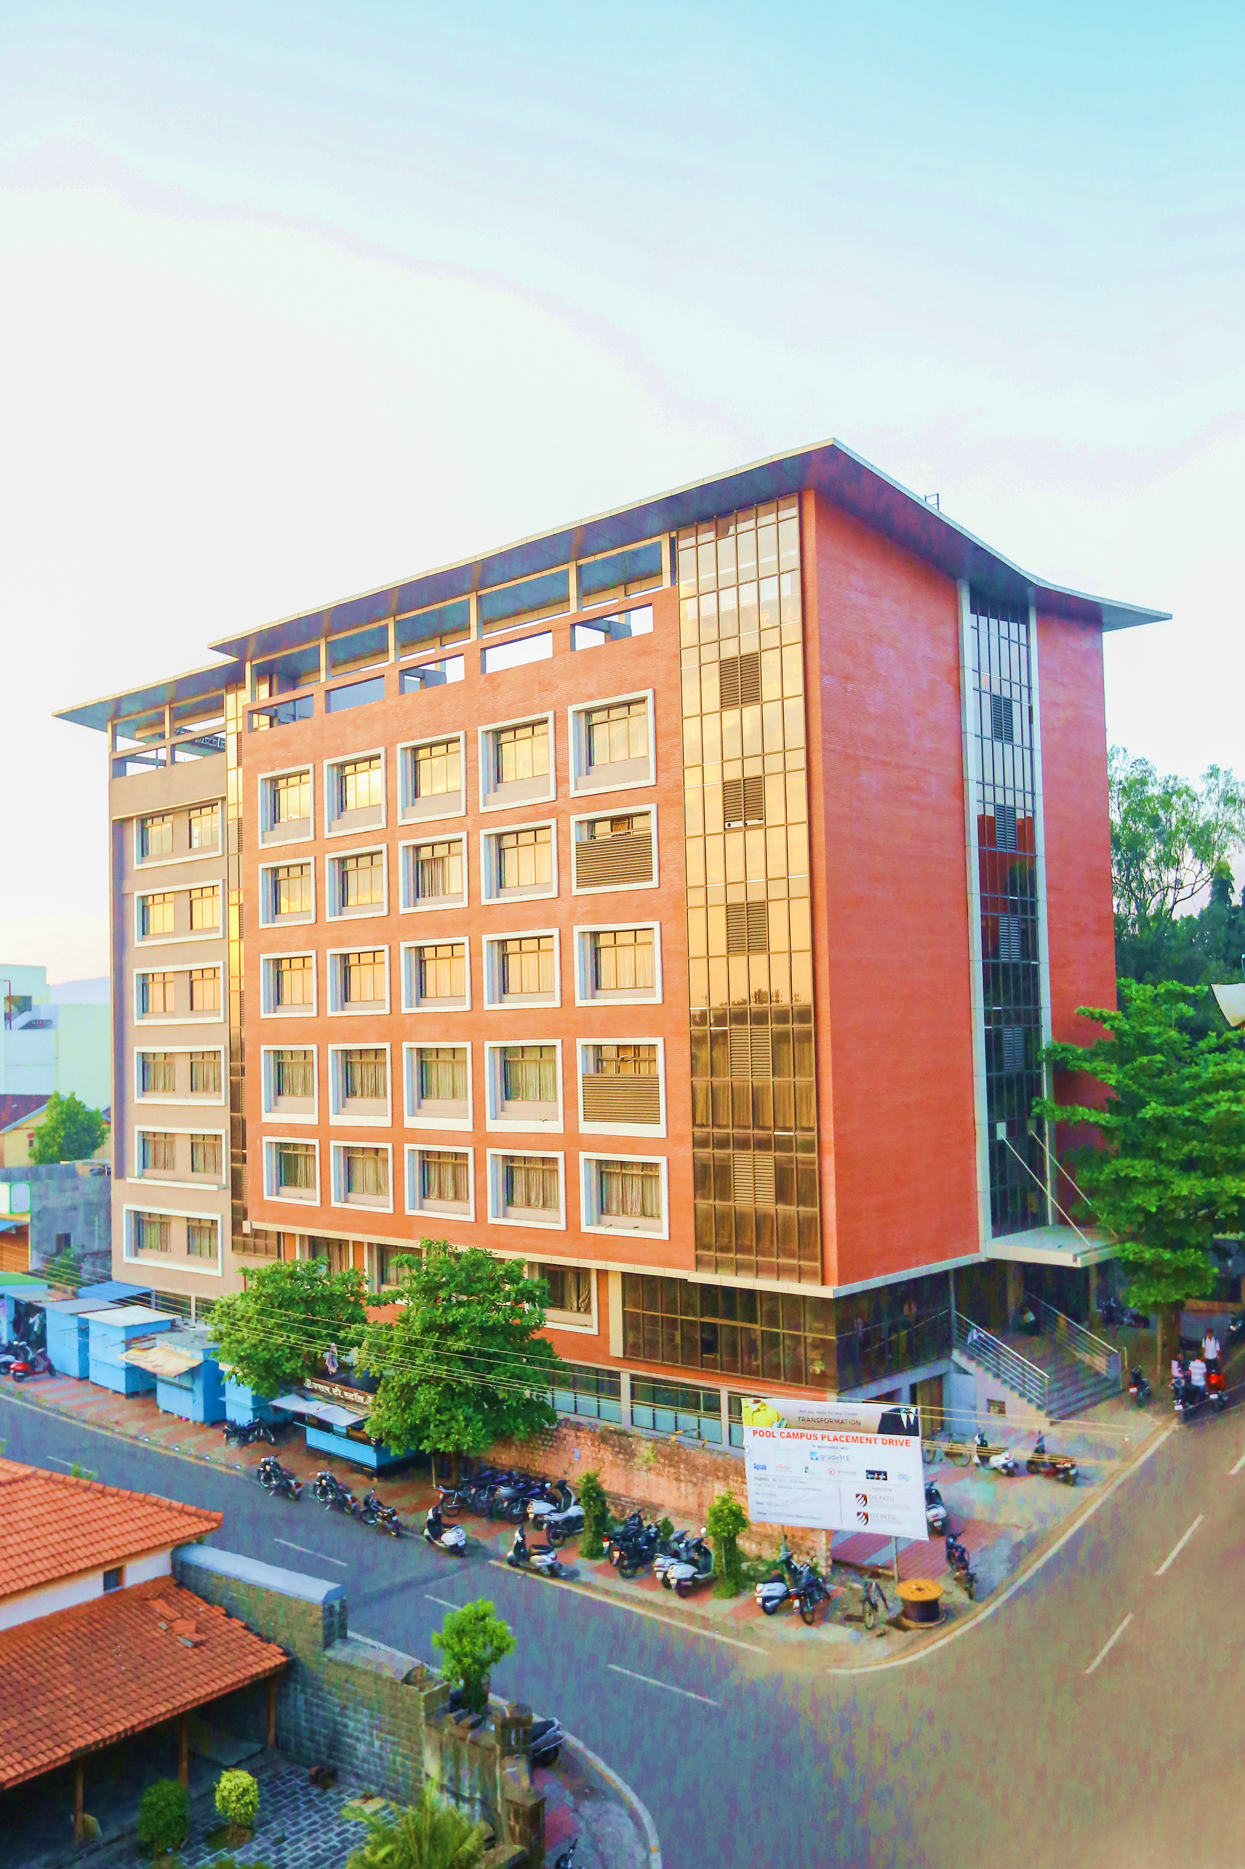

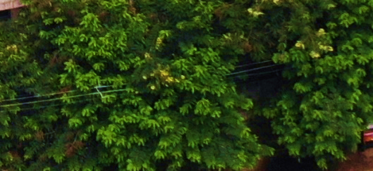
Begin your journey towards a successful career with DYPCET
Wishing you a Bright and Colorful Future ahead.
D. Y. Patil College of Engineering & Technology,
Kasaba Bawada, Kolhapur.
(An Autonomous Institute)
DTE Code –
Engineering – EN 6250,
Architecture – AR 6532
For admissions contact - 9158915999 / 9158615999
Thank You

